Slide 1
Fusion Metaheuristic algorithm for job shop scheduling problems with alternative routings
-Group 6
An extension of paper- Moon, Ilkyeong, Sanghyup Lee, and Hyerim Bae. "Genetic algorithms for job shop scheduling problems with alternative routings." International Journal of Production Research 46.10 (2008): 2695-2705.

Slide 2
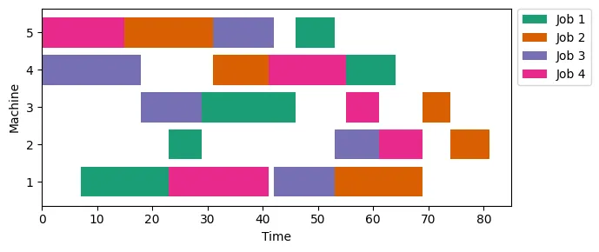
“Job-Shop Scheduling”?
Process planning and production scheduling are two of the most important functions of a manufacturing system.
In process planning, each machining operation is assigned to a certain machine tool, whereas in production scheduling, each machine is assigned different operations over time.
Optimizing them separately causes conflict of objectives resulting in sub-optmal solutions. So we integrate both to overcome this problem.
Image source- Mixed integer linear programming models for job scheduling -Medium Article, Author-Bruno Scalia

Slide 3
Job Shop Problems “with alternative routings” ?
In traditional Job Shop, each job follows fixed sequence of operation that “must” follow certain sequence of machines in order to get processed. However, in real world scenario, each operation within a job may be processed by different machines with different capability
This introduces flexibility in the problem. Even though alternative operations may incur time penalties, they may be used to offload bottleneck machines with the objective of balancing machine utilization and expediting the flow of workpieces.
M1- 1 hr
M2- 3 hrs
M3- 2 hrs
Job-J1
(O_11)
(O_12)
(O_13)
(3 operations)
M2- 4 hrs
M1- 2 hrs
M5- 2 hrs

Slide 4
Mixed Integer Linear Programming- Formulation, Constraints, Results
Job shop scheduling is typically an OR problem and this is best choice if our objective is to find best solution. However, OR optimization is heavily time consuming and is generally not applicable in real world job shop which has to optimize operations within 1000s of jobs every day. Hence, we implement MILP to compare performance of meta-heuristic algorithms against it.

Slide 5
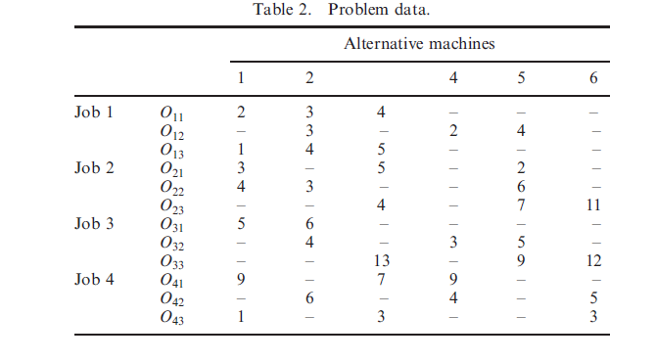
Dataset chosen to compare between algorithms
Citation- Moon, Ilkyeong, Sanghyup Lee, and Hyerim Bae. "Genetic algorithms for job shop scheduling problems with alternative routings." International Journal of Production Research 46.10 (2008): 2695-2705.

Slide 6
Notations (used in constraints and code)
i: Index for job, ranging from 1 to I.
j: Index for operation within a job i, ranging from 1 to Ji, where Ji is the number of operations required to complete job i.
k: Index for machine, ranging from 1 to K.
p: Index for the order of assignment to machine k, ranging from 1 to Nk, where Nk is the number of operations that belong to the set G(k).
Ji: Number of operations required to complete job i.
G(k): Set of operations that can be assigned to machine k.
Nk: Number of operations that belong to set G(k).
Oij: Operation number j of job i.
Sij: Starting time of operation Oij.
Fij: Finishing time of operation Oij.
Rkp: Release time of machine k after processing its pth operation in G(k).
tijk: Machining time of operation Oij on machine k.
ri: Time at which job i becomes ready for processing.
H: A very large positive number.
Xijkp: Binary variable where Xijkp = 1 if operation Oij has been assigned to machine k on the pth order, and 0 otherwise.

Slide 7
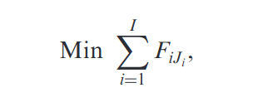
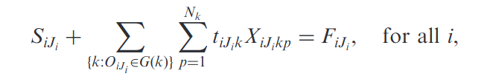

Objective Functions & Constraints
Objective Function- (Minimize Sum total of Flow Time of all jobs)
Constraint 1- Starting time of the (j+1)th operation of a job must be greater than or equal to the finishing time of the jth operation of the same job.
Constraint 2- Starting time of the first operation of each job must be greater than or equal to its ready time.

Slide 8
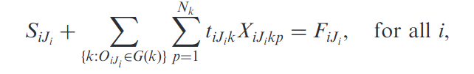
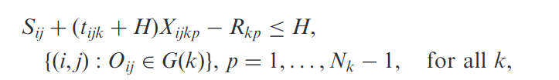

Constraints (Contd.)
Constraint 3- Starting time of the last operation of each job, added with the processing time of the final operation, should equal the finishing time of each job.
Constraint 4- Relationship between the release time of machine k and the operation assigned to the machine.
Constraint 5- Starting time of an operation assigned to machine k in the (p+1)th order must be greater than or equal to the release time of the machine after the completion of its pth operation.

Slide 9

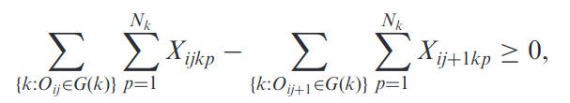
Constraints (Contd.)
Constraint 6- Release time of machine k after the completion of its (p+1)th operation must be greater than or equal to that after its pth operation.
Constraint 7-The (p+1)th operation that belongs to G(k)can be assigned only after the pth operation.
Constraint 8-The (j+1)th operation of a job can only be assigned after the pth operation has been assigned to a machine.

Slide 10



Constraints (Contd.)
Constraint 9- No more than one operation can be assigned to a machine simultaneously.
Constraint 10- Each operation must be assigned to a machine.
Constraint 11-
DV- X_{i,j,k,p} and S_{i, j}

Slide 11
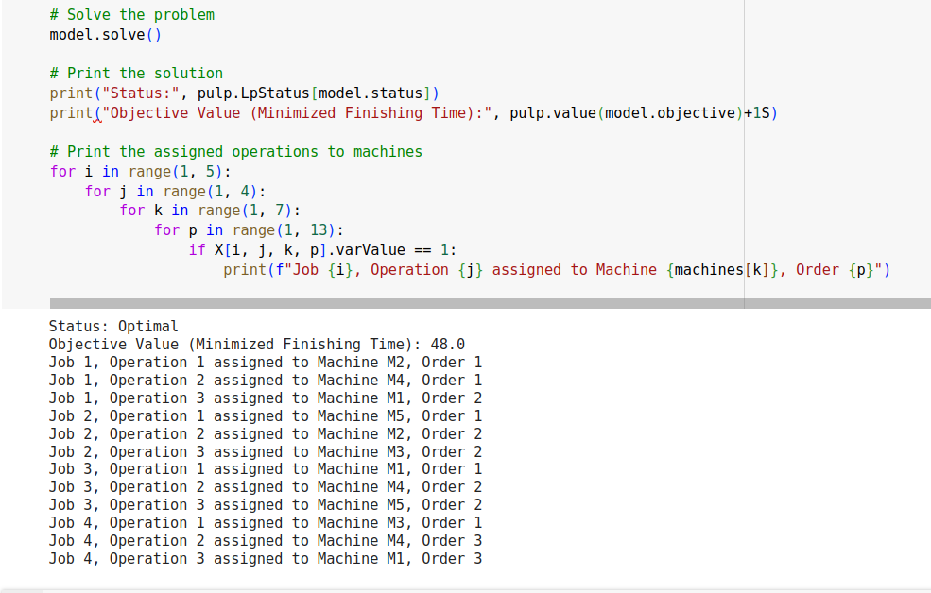
Result from code (Python-pulp library)

Slide 12
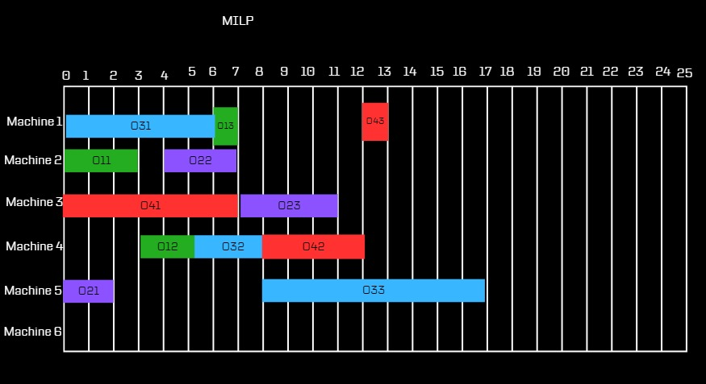
Result Visualization
Sum Flow Time = 48 (7,11,17,13)

Slide 13
GENETIC ALGORITHM-IMPLEMENTATION
.

Slide 14
Genetic algorithms, start with an initial set of (random) solutions called a population.
Each individual in the population, which is called a chromosome, represents a solution to the problem at hand.
The chromosomes evolve through successive iterations called generations.
During each generation, the chromosomes are evaluated using some measures of fitness.

Slide 15
In our genetic algorithm, we can search the assignment of each operation to each machine through operations of the genetic algorithm.
Our chromosome is composed of two parts-
The first part is for the assignment of alternative machines
The second part is the relative processing order between jobs
The length of each chromosome is equal to the total number of operations, that is ∑^{I}_{i=1} J_{i .}

Slide 16
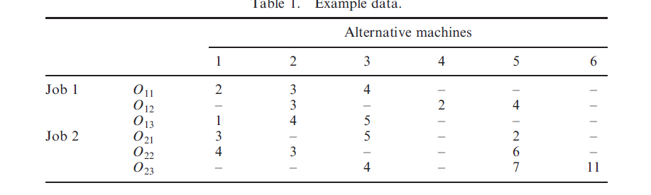
Dataset

Slide 17
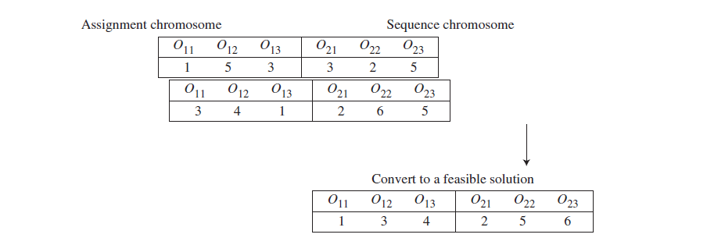
To illustrate the chromosome, we use the data in table 1, where there are two jobs and six alternative machines.
Suppose a chromosome is given as shown in the figure given below-

Slide 18
O11 is 1 (in the assignment chromosome), which means that the first operation of job 1 is assigned to machine 1, and O12 is 5, which means that the second operation of job 1 is assigned to machine 5.
The genes that belong to the same job (in the sequence chromosome) must be converted before assigning the jobs to the machines.
The conversion of the orders on each job to an increasing order (shown in figure 2) guarantees a feasible solution. O13= 4 and O21=2 imply that O21 is assigned second,and O13 is assigned fourth, which implies that O21 should be assigned prior to O13 on machine 3.

Slide 19
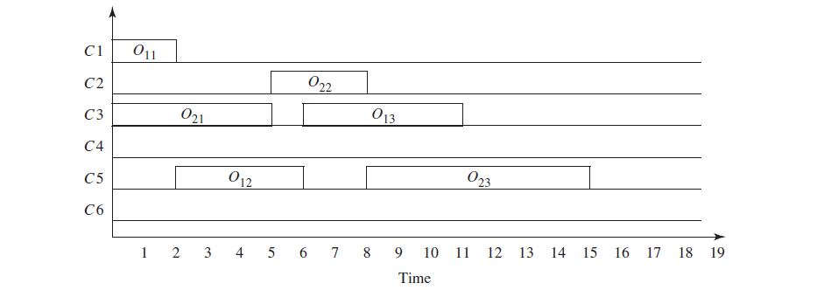
The chromosome can be converted into a feasible schedule, as shown
in the figure.

Slide 20
Assignment Chromosome:
In the context of scheduling jobs on machines, assignment refers to the allocation of each operation of a job to a specific machine.
Each gene in the chromosome represents an operation of a job.
The value of each gene indicates the machine to which the corresponding operation is assigned.

Slide 21
Sequential Chromosome:
In the context of job scheduling, a sequential chromosome represents the order in which operations of different jobs are scheduled.
Each gene in the chromosome represents an operation of a job, and the order of these genes represents the sequence of operations.
The chromosome encodes the sequence in which the operations are processed across different jobs and machines.

Slide 22
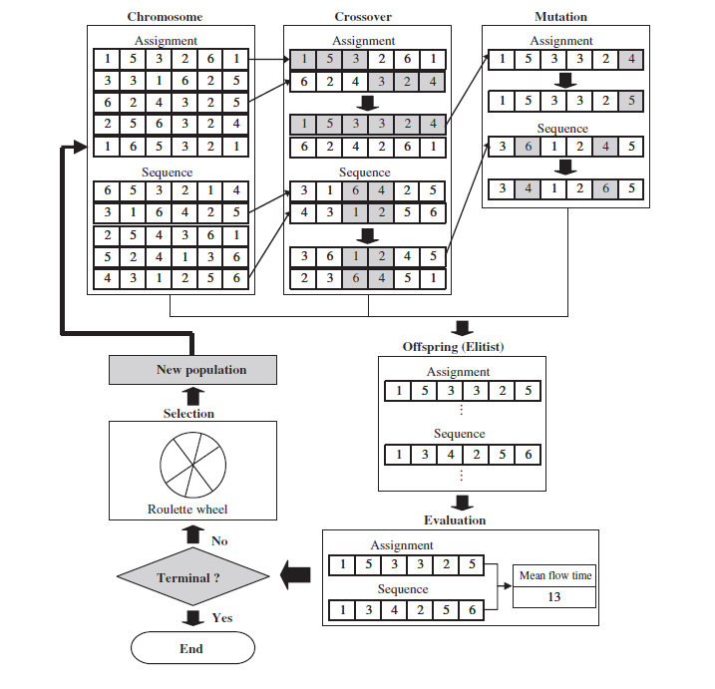

Slide 23
The parameters used for solving this problem are listed below-
. Population size: 20.
. Elitist strategy (the best individual was always retained from generation to generation).
. The termination condition was achieved when the number of generations reached 1000.
. Crossover rate: 0.8.
. Mutation rate: 0.01.

Slide 24
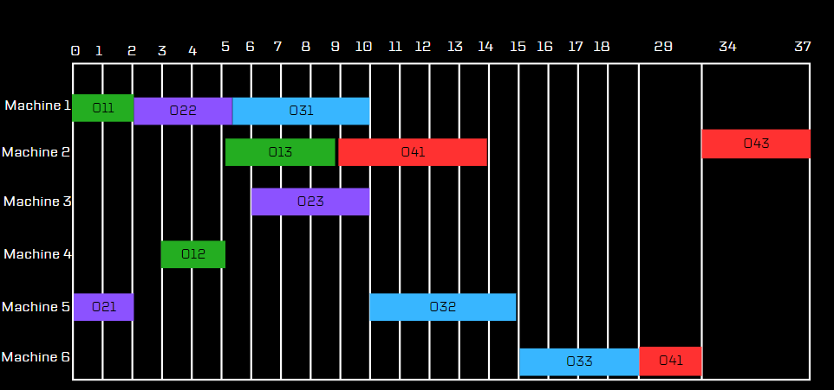
Result for Genetic Algorithm
Best Flow Time : 56
Best Assignment Chromosome : [2,4,2,5,1,3,1,5,6,3,6,3]
Best Sequence Chromosome : [1,2,3,4,5,6,7,8,9,10,11,12]

Slide 25
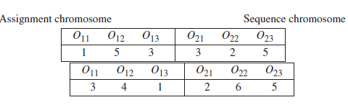

Tabu + GA Fusion: Assignment and Sequence Chromosomes
Objective Function- (Minimize Summation of Flow Time of all jobs)
Example Representation in Paper of Assignment and Sequence Chromosome-
Example Representation of Assignment and Sequence Chromosome-

Slide 26
Fitness Calculation
First we evaluate the fitness as a function of Assignment Chromosome and Sequence Chromosome.
We initialize flow time as 0
Then for every operation in the sequence chromosome we first check the machine number, and the availability of the machine from the assignment chromosome.
Then we calculate the total processing time of the operation as the processing time for that particular operation in addition to the previous processing times for the operation being performed on the respective machine number earlier.
Then we calculate the total flow time as, initial flow time plus the total processing time.

Slide 27
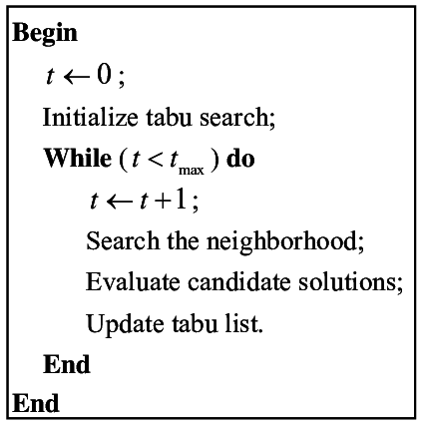
The Important Parameters for Tabu Search for parent Generation:
Tabu List Length : 2
Iterations : 5
Populations to be generated : 20
Aspiration Criteria : Better than Previous Flow time
Now after generating the best set of parents using tabu search , We used this set of parents to Genetic Algorithm for getting the best solution

Slide 28
Generating Neighbor Solutions:
In each iteration, a neighboring solution is generated by performing a swap operation on the sequence and assignment chromosome. Two random indices are chosen (index1 and index2) within the sequence chromosome, and the operations at these indices are swapped. This swapping of operations changes the order in which the operations are performed.
Evaluating Neighbor Fitness:
After generating a neighbor solution, its fitness is evaluated. Fitness here typically represents some measure of how good the solution is (which is Flow Time ). In this case, it's likely related to the efficiency or optimality of the assignment and sequence of operations.
Accepting or Rejecting Neighbor Solutions:
If the fitness of the neighbor solution is better than the current best solution and the neighbor solution is not in the tabu list, it is accepted as the new current solution. Otherwise, it may still be accepted based on some probability determined by the algorithm, but in this implementation, it seems that only better solutions that are not in the tabu list are accepted.

Slide 29
Managing Tabu List:
The current sequence chromosome (representing the order of operations) is added to the tabu list to prevent revisiting similar solutions in the future.
The tabu list has a maximum size specified by tabu_size. When the tabu list exceeds this size, the oldest solutions are removed from the list
Termination :
The algorithm terminates after the specified number of iterations (max_iterations) is reached.
Finally, the best assignment chromosome, best sequence chromosome, and the corresponding fitness value are returned as the output of the Tabu Search algorithm.
Best Parent we got from the tabu search which would be given as Input to Genetic Algorithm
Fitness: 59
Assignment chromosome : [2,4,3,1,5,3,1,4,3,4,6,1]
Sequence Chromosome : [1,2,3,4,5,6,7,8,9,10,11,12]
Note : we have evaluated each parent generated by assigning a separate evaluation function ( which checks the sequence of jobs and help to maintain sequence in the order of operations for eg O11 before O12 and O13 and so on for other all the jobs)

Slide 30
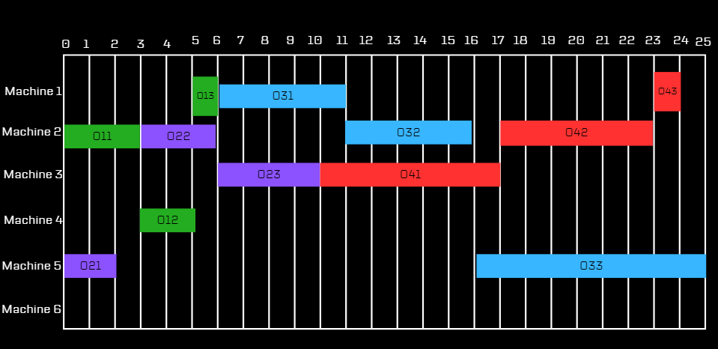
Fusion Algorithm Result: Tabu + Genetic Algo
Fusion Algorithm Output : Best Flow Time : 47
BA = [2,4,3,1,5,3,1,4,3,4,6,1]
BS = [1,2,3,4,5,6,7,8,9,10,11,12]

Slide 31
Comparison of Results
Algorithm | Total Flow Time | Job Flow Time
Mixed Integer Linear Programming | 48 | 7,11,17,13
Genetic Algorithm | 56 | 9, 10, 18, 19
Fusion Algorithm (TS+GA) | 49 | 6, 10, 9, 24

Slide 32
Team Members & Topics assigned
1.Mohammed Fayiz Parappan (20IM30010 ): Problem Formulation, Mixed Integer Linear Programming Constraints & solution generation
2.Oindrila Maji (20IM30013): Genetic Algorithm solution generation
3. Sanil Upasani (20IM30026): Tabu Search Algorithm solution generation
4. Ronit Wanare (20IM30027): Tabu Search Algorithm solution generation, Fusion Algorithm Results

Slide 33
Thank You
Open to Feedback & Questions

